Slide 1

BANK CUSTOMER CHURN PREDICTION MODEL
Understanding bank customer churn is key to retaining loyalty and enhancing customer experience
PRESENTED BY: AFTAB KHAN

Slide 2

DATASETS STORY
It consists of 10000 observations and 12 variables.
2.Independent variables contain information about customers.
3.Dependent variable refers to customer abandonment.
4. Target Variable is churn.

Slide 3

EXPLORATORY DATA ANALYSIS
Exploratory Data Analysis (EDA) helped us understand the data structure, find patterns, identify trends, and gain valuable insights from the dataset.
From EDA we analyze, the distribution of each features, checking the correlation between the features .
Using visuals helped us see the data clearly, understand customer behavior, and pinpoint factors that might cause customers to leave.
The datasets is clean ,there is no NULL & DUPLICATE VALUES

Slide 4
DISTRIBUTION OF TARGET VARIABLE
From above pie chart we can see that our target variable distribution is highly imbalanced.
2.Majority of the customers is Retained (79.63%)
3.Only (20.37%) customers are Churning.

Slide 5
VISUALIZATIONS
Majority of the customer are Male(54.57%)
2.On otherside Female are (45.43%)
Majority of customer have credit card(70.55%).
2.(29.45%) customer does not have credit card.
51.51% are Active customer.
2.48.49 are Non Active customer

Slide 6
The majority of male customers (70.85%) and female customers (70.27%) own a credit card. However, there are more male customers without a credit card compared to female customers, suggesting an opportunity for targeted marketing or financial services to increase credit card adoption among male customers.
About half of male (52.54%) and female (50.27%) customers are active.
Gender doesn't significantly affect activity levels.

Slide 7
France has the most churning customers, followed by Germany and then Spain.
However, Spain has the highest retention rate (83.33%), followed by France (83.88%) and then Germany (67.58%).
This suggests France's retention efforts are effective despite high churn, while Germany may need to improve its retention strategies.

Slide 8
Credit card holders show a slightly higher retention rate (79.8%) than non-cardholders (79.17%), despite higher churn among cardholders, suggesting a correlation between credit card ownership and retention rates.
Active customers have a higher retention rate (85.9%) than inactive ones (73.13%), showing the impact of customer activity on retention. Engagement strategies can boost retention and reduce churn.

Slide 9
The customer have one year relationship with bank majority are churning.
From 1 to 9 years relations majority of them are churning
Customer with 0 and 10 are in minority those who are churning.
Customers with more products tend to have higher retention rates. Specifically, customers with one product have the highest churn rate, followed by those with two, three, and four products successively.
This suggests that increasing the number of products per customer may lead to higher retention rates, indicating potential opportunities for upselling or cross-selling strategies to improve customer loyalty.

Slide 10
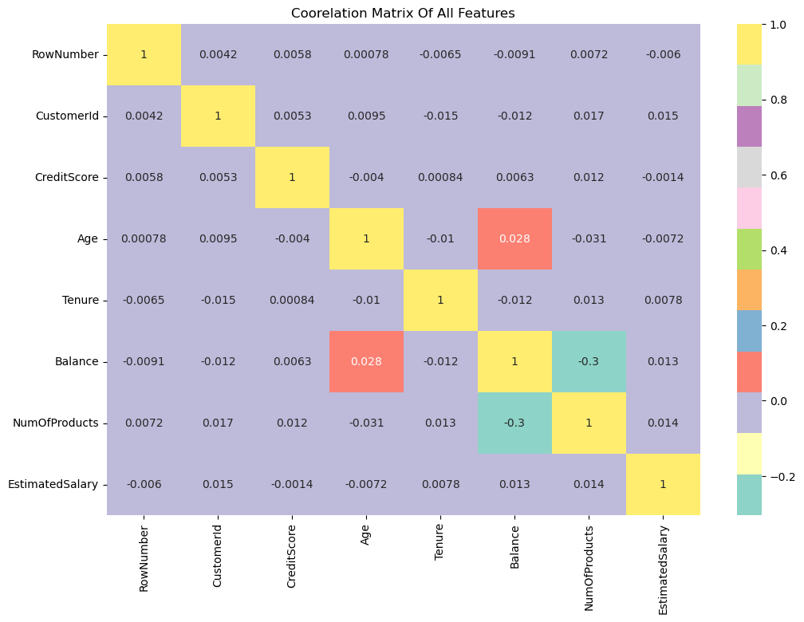
HEATMAP
From above heatmap we observed that:
There is no features with Highly Correlated
Balance and NumOfProducts are negatively correlated with points (-0.3)
Age and Balance are correalted with points (0.028)

Slide 11


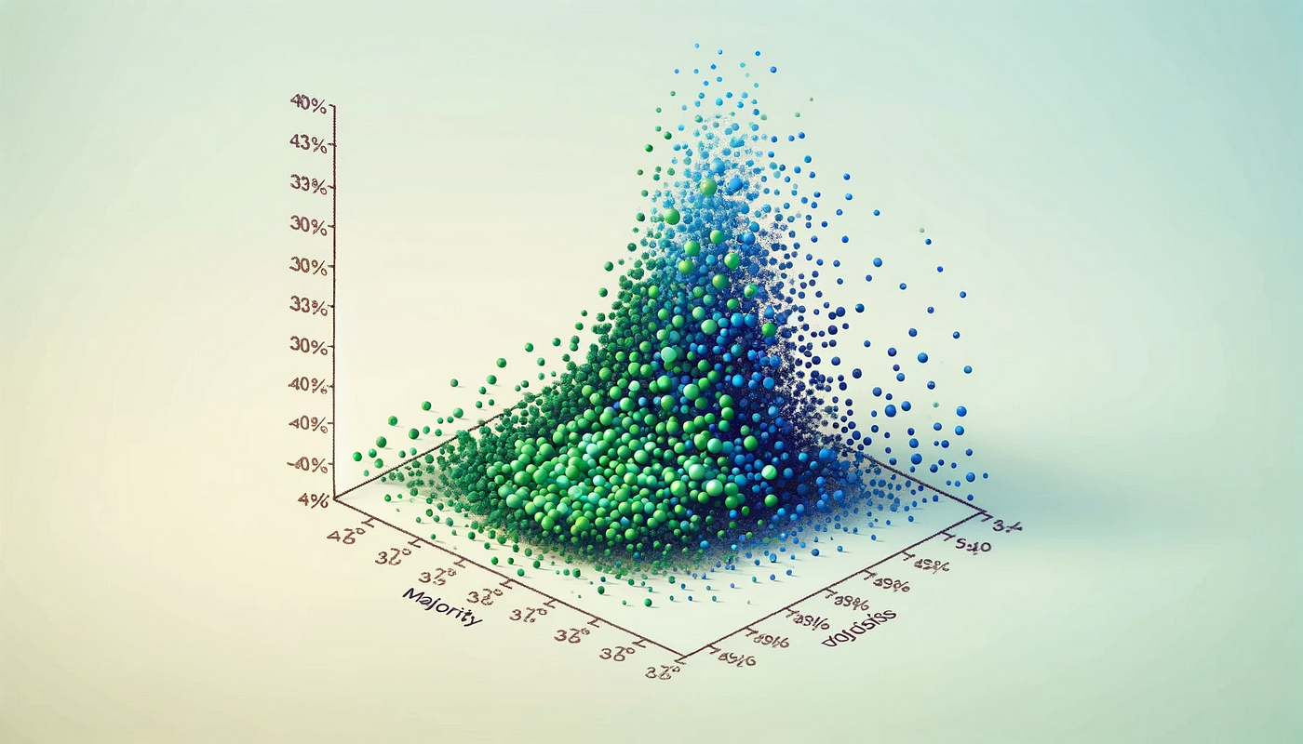
PREPROCESSING
Dropped Irrelevant Features: "RowNumber", "CustomerId", "Surname" to reduce noise.
Label Encoded Gender: Converted categorical gender feature into numerical format.
One-Hot Encoded Geography: Transformed categorical geography feature for better model interpretation.
Standard Scaling: Applied to normalize feature values for uniformity.
SMOTE Technique: Used to address class imbalance by oversampling the minority class.

Slide 12
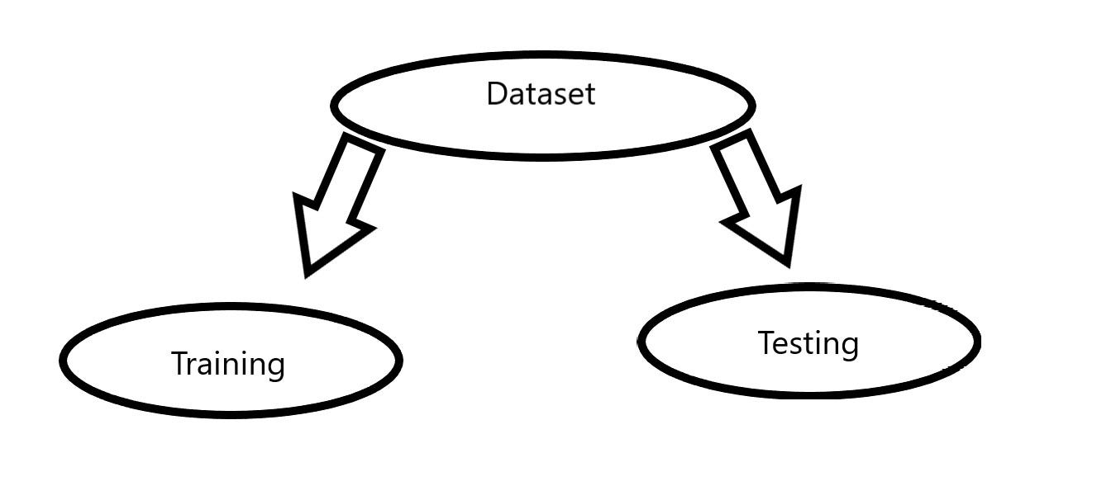
SPLITING THE DATA INTO X & Y
We divided the dataset into two parts: X and y.
"X" typically represents the independent Variables, and "y" represents the Dependent (target variable) that we want to predict or understand.
TRAIN TEST SPLIT
We divided the data into training (80%) and testing (20%) sets.
Setting a random state of 123 ensures consistent results, and using stratify=y maintains a proportional distribution of the target variable in both sets.

Slide 13
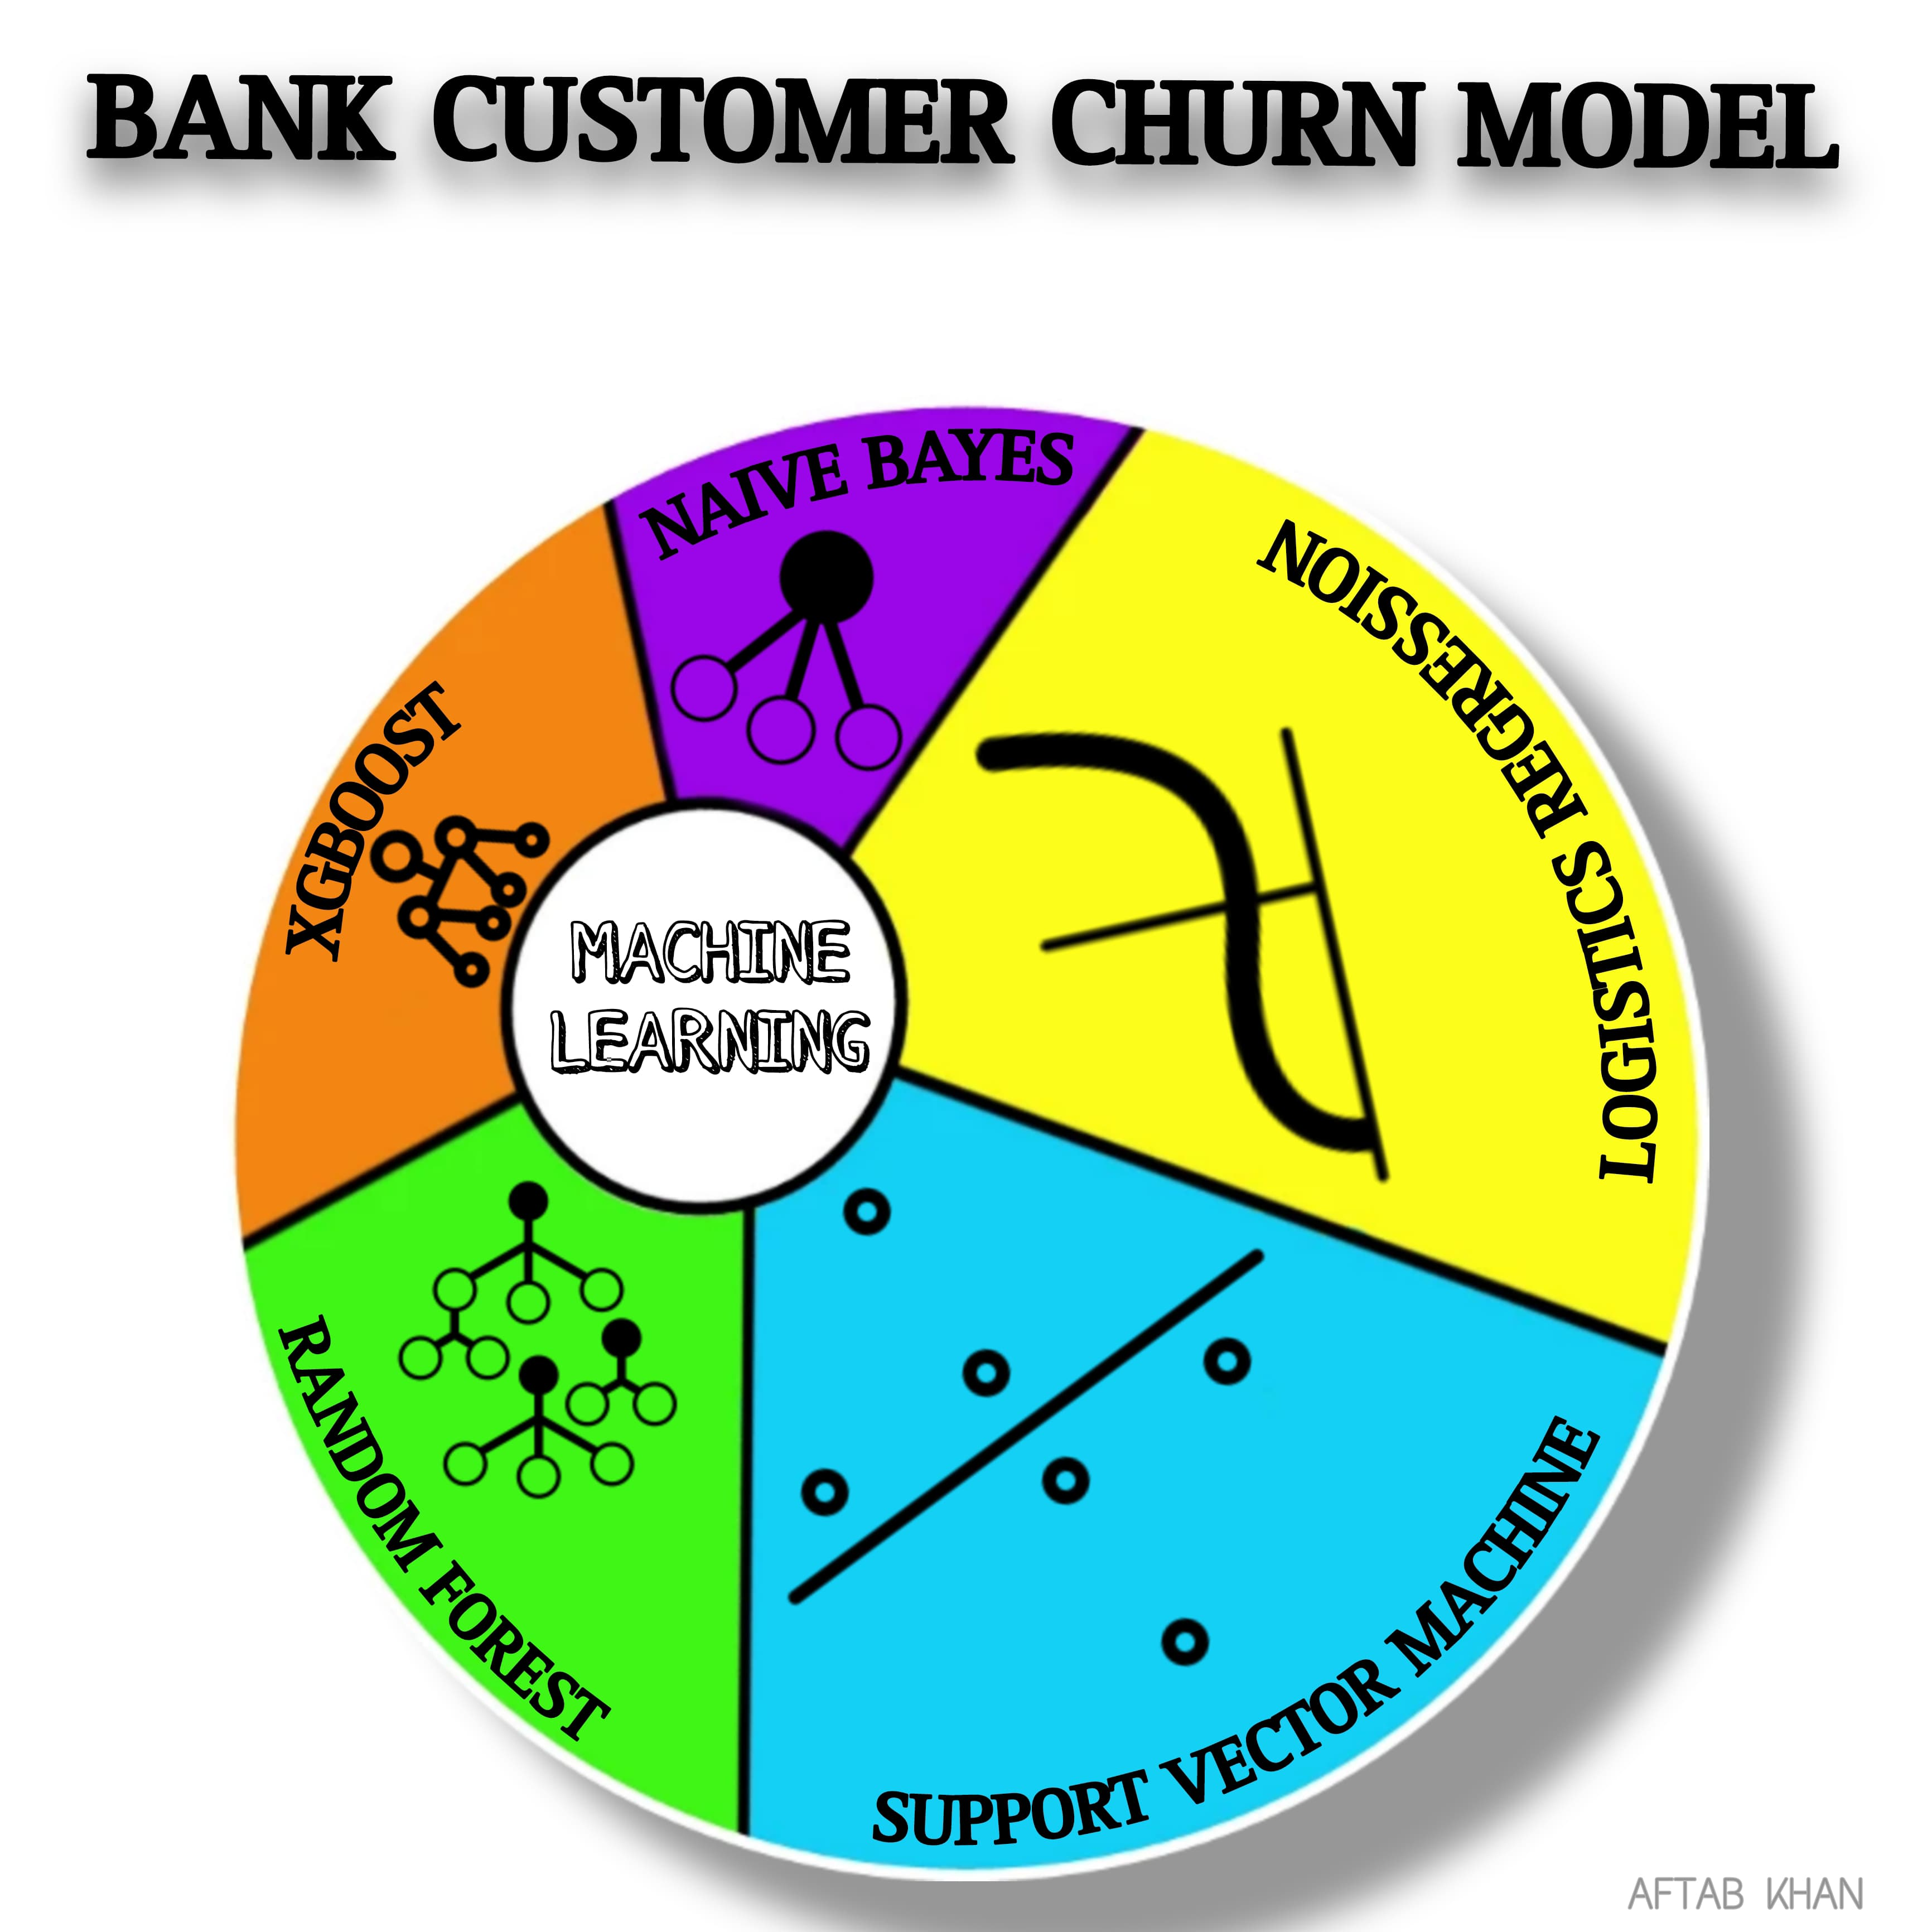
MODEL SELECTION
I am planning to apply Five algorithms as they are effective in handling imbalanced datasets .And working best on Small datasets.
LOGISTIC REGRESSION
NAIVE BAYES
SUPPORT VECTOR MACHINE
RANDOM FOREST
XGBOOST

Slide 14
ROC AUC SCORE
The ROC AUC (Receiver Operating Characteristic Area Under the Curve) score is a metric that measures the performance of a binary classification model. It is a good metric for imbalanced datasets because it considers both true positive and false positive rates, providing a comprehensive evaluation of the model's ability to correctly classify both classes despite imbalanced class distributions.
MODEL EVALUATION
Five ML Algorithms: Logistic Regression, Naive Bayes, Support Vector Machine, Random Forest, and XGBoost.
Initial Performance: Random Forest initially outperformed other algorithms based on ROC AUC scores.
Hyperparameter Tuning: XGBoost achieved the highest ROC AUC score of 0.856769 after tuning, surpassing Random Forest and other algorithms.

Slide 15

CONCLUSION
Data Preparation: Proper preprocessing techniques were applied to handle categorical features, scale data, and address class imbalance.
Model Performance: XGBoost, after hyperparameter tuning, demonstrated superior performance with the highest ROC AUC score, indicating its effectiveness in predicting churn.
Recommendation: Based on these results, XGBoost is recommended as the preferred model for predicting churn in this dataset. However, further analysis and model refinement may be beneficial for even better predictive performance.

Slide 16


